Slide 1


Slide 2

Introductions
Michelle Johnson: CEO
Myles Walsh: CFO
James Goodrich: COO
Ashley Kirby: CTO

Slide 3
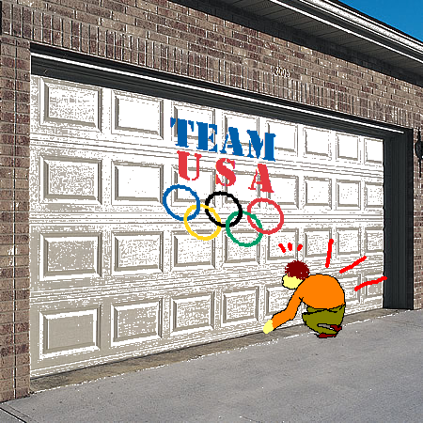
What is the problem?
We have a manual garage door we want to automate

Slide 4
Possible solutions
Get rid of the garage door all together
  Pros
    No code to be written
    Possible extra room
  Cons
    No place to store car
    Possible theft

Slide 5
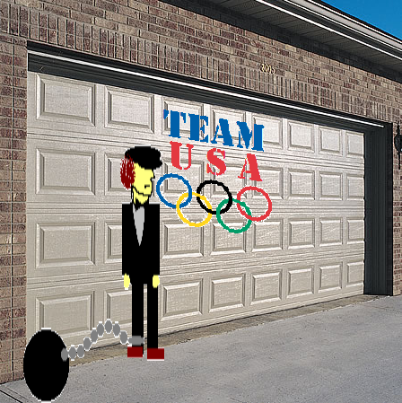
Possible solutions
Hire someone to open the garage door on command
  Pros
    New friend
    Works even when the power is out
  Cons
    Overhead

Slide 6
OUR solution
The G-DOS: Garage Door Opener System
    The G-DOS is about providing convenience to the client to allow them to access their garage using an automated system.

Slide 7
What does it include?
The garage door opener
A stationary control
A remote control

Slide 8
Basic requirements
The remote control and stationary devices send signals to the motor
The motor pulls the door up and pushes the door down
The work light comes on when the motor is activated and will remain on 5 minutes after activation unless overridden

Slide 9
Pre-conditions
The door must be closed
The motor must be off and not have run within the past 5 minutes
The remote control is enabled
The work light is off

Slide 10
What are we not concerned with
Security code settings
The obstruction detection system
Range limitations of the remote control

Slide 11
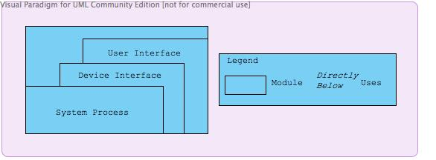
Layered Architecture

Slide 12
layered ARCHECTURE RESPOSIBLITIES
User Interface
  Interfaces between the user of the product and the devices
Device Interface
  Interfaces between the user interface and the system itself
System Process
  Interfaces with all of the components of the system and assists in performing lower level functions

Slide 13
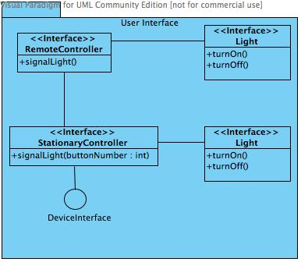
User Interface DECOMPOSITION

Slide 14
User Interface
Responsible for informing the user of the device states through the use of telltale lights located on the controllers
The light module will turn on or off, depending on the state of the system

Slide 15
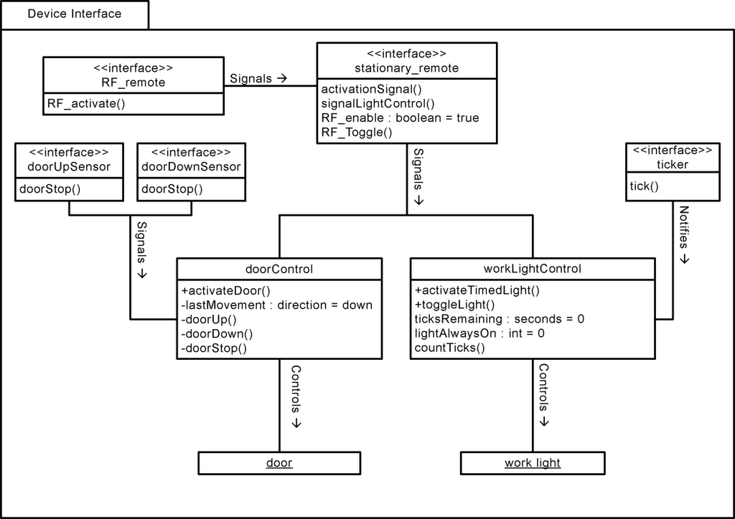
Device Interface DECOMPOSITION

Slide 16
Device Interface
Implements control of the system process layer
Provides service interfaces to the user interface level
Responsible for the logic processes of the garage door opener system

Slide 17
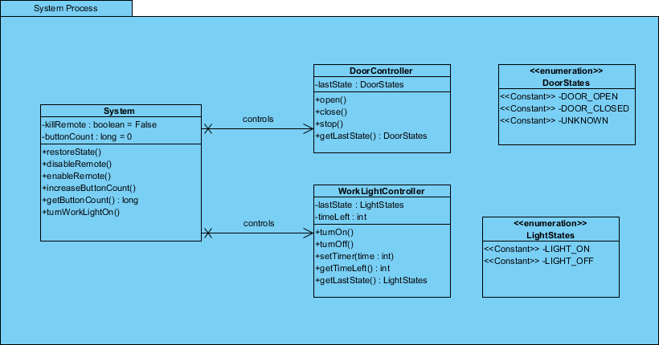
System Process Decomposition

Slide 18
System Process
Restore state is saved in persistent store
Garage door commands go to the door controller
Work light commands go to the work light controller

Slide 19
What is the G-DOS?
The G-DOS is easily modifiable
  We can do the following:
    Add a new type of control device
    Add a new type of sensor
The G-DOS is adaptable
  We can do the following:
    Add a type of control
    Add a new light
    Add a new garage door

Slide 20
What is the g-dos?
The G-DOS is reusable
  We can use the G-DOS with any type of vehicular product
The G-DOS is reliable
  The G-DOS has built in back up systems for both motor failure and power loss
The G-DOS has excellent performance
  The G-DOS is able to execute commands in realtime

Slide 21
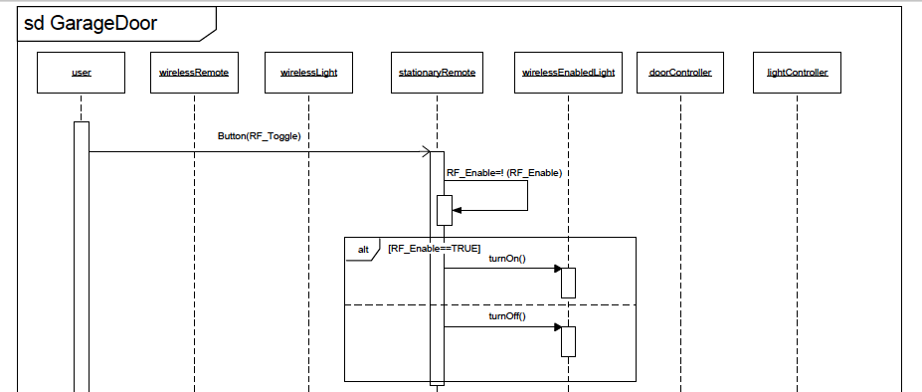
How does it work?

Slide 22
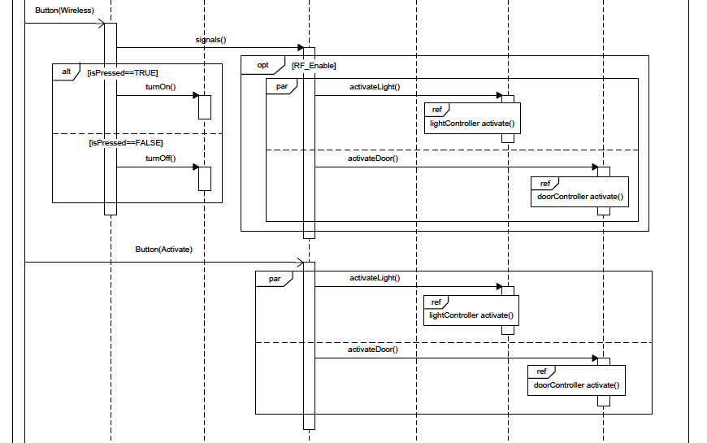
How does it work?

Slide 23
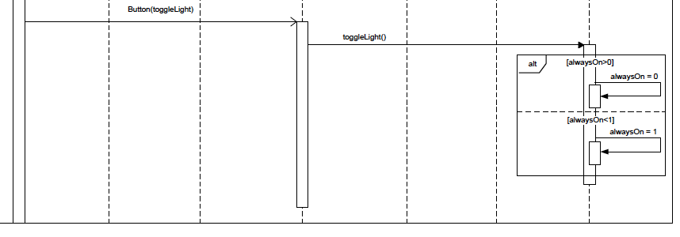
How does it work?

Slide 24
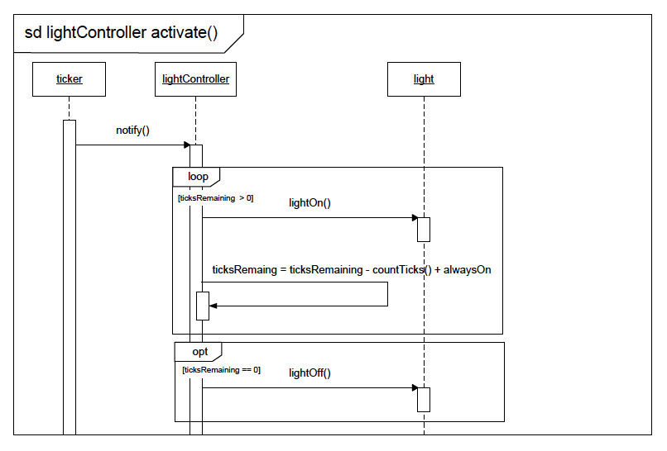
How does it work?

Slide 25
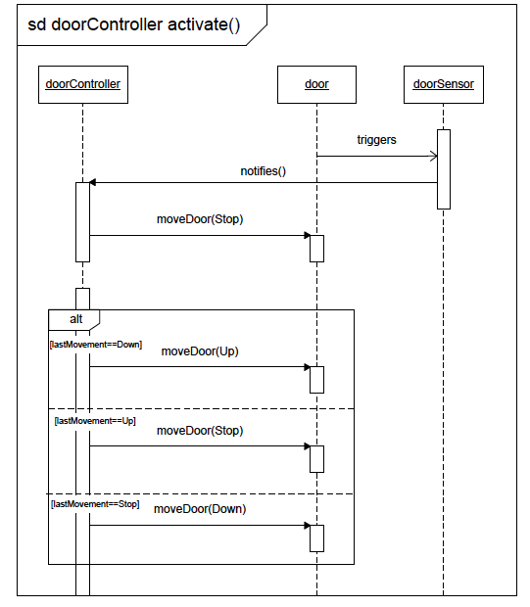
How does it work?

Slide 26
Design Rationale
Our layered architecture was designed with simplicity and adaptability in mind
The user interface is a modular component of the design
It is easy to add new components to the system process due to the adaptable aspect of the design

Slide 27
